Slide 1
Adding Fluidity to a Website

Slide 2
Objectives
In this session, you will learn to:
  Understand fluid grids

Slide 3
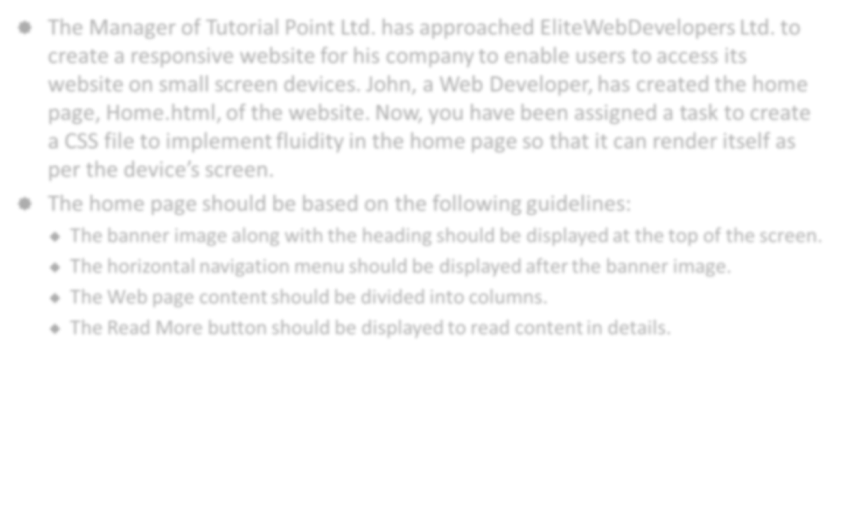

Activity: Implementing Fluidity in a Web Page
The Manager of Tutorial Point Ltd. has approached EliteWebDevelopers Ltd. to create a responsive website for his company to enable users to access its website on small screen devices. John, a Web Developer, has created the home page, Home.html, of the website. Now, you have been assigned a task to create a CSS file to implement fluidity in the home page so that it can render itself as per the device’s screen.
The home page should be based on the following guidelines:
  The banner image along with the heading should be displayed at the top of the screen.
  The horizontal navigation menu should be displayed after the banner image.
  The Web page content should be divided into columns.
  The Read More button should be displayed to read content in details.

Slide 4
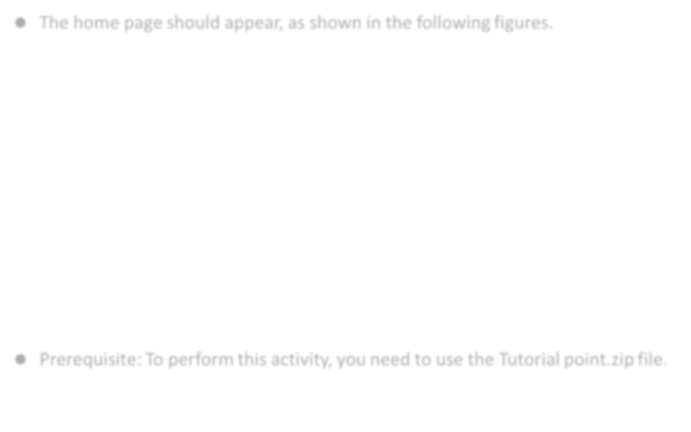
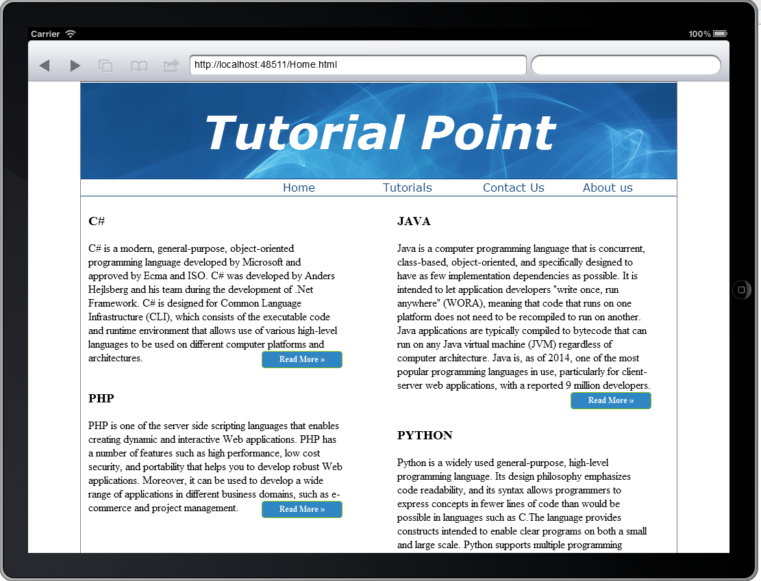
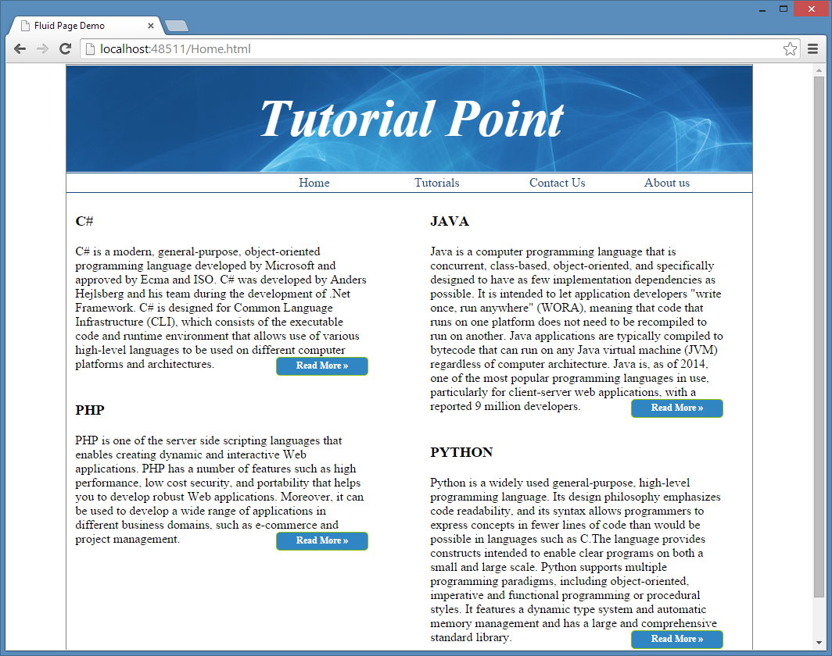
Activity: Implementing Fluidity in a Web Page (Contd.)
The home page should appear, as shown in the following figures.
Prerequisite: To perform this activity, you need to use the Tutorial point.zip file.

Slide 5
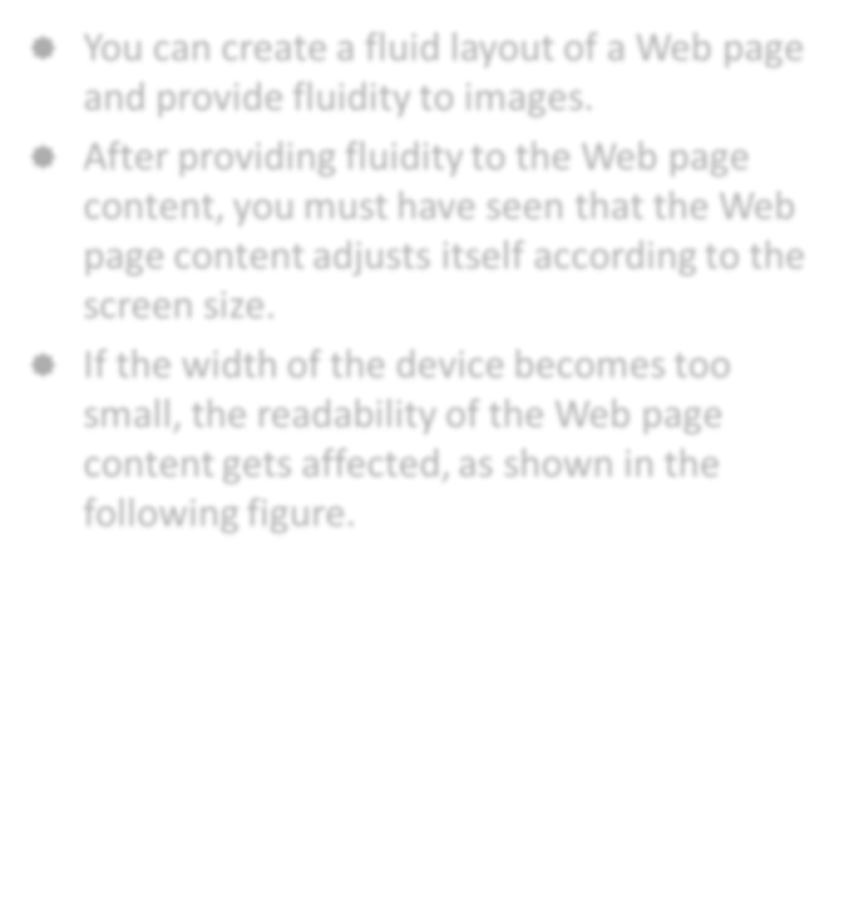
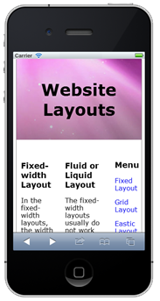
Using Fluid Grids with Media Query
You can create a fluid layout of a Web page and provide fluidity to images.
After providing fluidity to the Web page content, you must have seen that the Web page content adjusts itself according to the screen size.
If the width of the device becomes too small, the readability of the Web page content gets affected, as shown in the following figure.

Slide 6
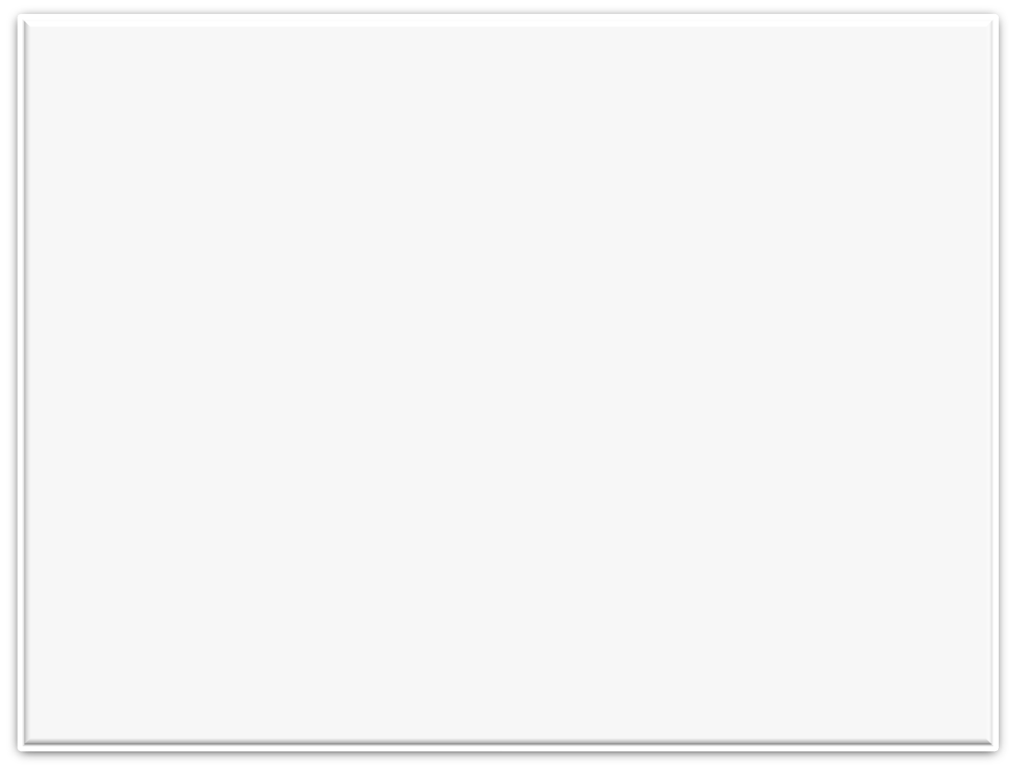
Using Fluid Grids with Media Query (Contd.)
To avoid the readability issue, you need to use fluid grids with media queries, as shown in the following code snippet:
@media screen and (max-width: 480px)
{
#container {
margin-top: 2px;
}
.heading {
font-size: 18pt;
text-align: center;
padding: 40px;
}
content {
width: 95%;
margin-top:-20px;
}
#leftcontent {
margin: 0px;
padding: 0px;
text-align: justify;
float: none;
padding-right: 25px;
width: 95%;}

Slide 7

Using Fluid Grids with Media Query (Contd.)
#rightcontent
{
width: 95%;
margin: 0px;
padding-right: 25px;
text-align: justify;
float: none;
}
aside
{
display: none;
}
h3
{
font-size: 12pt;
}
p
{
font-size: 9pt;
}
footer {
padding-top: 1px;
padding-bottom: 1px;
}
}

Slide 8
Using Fluid Grids with Media Query (Contd.)
In the preceding code snippet:
  Media queries define different styling for different screen sizes.
  The sizes of elements within the media queries are specified in terms of percentages instead of pixels.

Slide 9
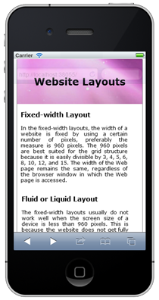
Using Fluid Grids with Media Query (Contd.)
After implementing the preceding media query code snippet, the Web page will display its content in a more readable form on small screen devices, as shown in the following figure.

Slide 10
Activity: Adding Fluidity to the FoodHub Website
After implementing the media query feature in the Foodhub website, you noticed that the Web pages are getting cropped in devices having small screens, such as tablet or smartphone. You noticed that this is happening because Web pages are designed by using a fixed layout, which makes them adaptive by nature. Therefore, the management assigns you a task to add fluidity in the website and make it responsive so that customers can access the Foodhub website in the small screen devices.
The home page of the Foodhub website should be based on the following guidelines:
  If the minimum width of the device screen is less than 920px, the toggle menu should appear. Else, the Web page should render in 1200px.
  If the minimum width of the device screen is less than 480px, the banner image should appear in the left side and the menus should float in the right side.

Slide 11

Activity: Adding Fluidity to the FoodHub Website (Contd.)
The home page should appear, as shown in the following figures.

Slide 12


Activity: Adding Fluidity to the FoodHub Website (Contd.)
Prerequisite: To perform this activity, you need to use the Foodhub.zip and jQuery.zip files.

Slide 13
Summary
In this session, you learned that:
  If the width of the device becomes too small, the readability of the Web page content gets affected.
  To avoid the readability issue, you need to use fluid grids with media queries.

Slide 14
What’s Next?
After this session, you need to do the following tasks:
  Read Chapter 4
  Perform the following exercises of Chapter 4:
    Exercise 1
    Exercise 2
    Exercise 3

